Slide 1
Gravitational Waves
Fundamentals and Early History 2
Peter Saulson
Martin A. Pomerantz ‘37 Professor of Physics
Syracuse University

Slide 2
Outline for Day 2
How an interferometer senses a gravitational wave
The “rubber ruler” puzzle
What does it take to accomplish the “impossible” task of gravitational wave detection?

Slide 3
Gravitational waveform lets you read out source dynamics
The evolution of the mass distribution can be read out from the gravitational waveform:
Coherent relativistic motion of large masses can be directly observed from the waveform!

Slide 4
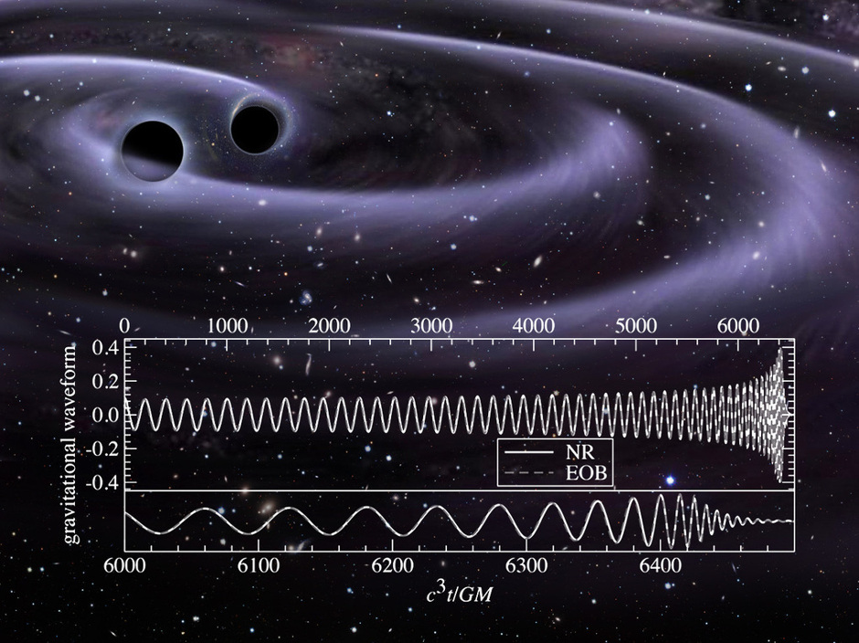
Pattern of oscillations from black hole inspiral and merger

Slide 5
Gravitational waves
Gravitational waves propagating through flat space are described by
A wave propagating in the z-direction can be described by
Two free parameters implies two polarizations

Slide 6
Plus polarization

Slide 7
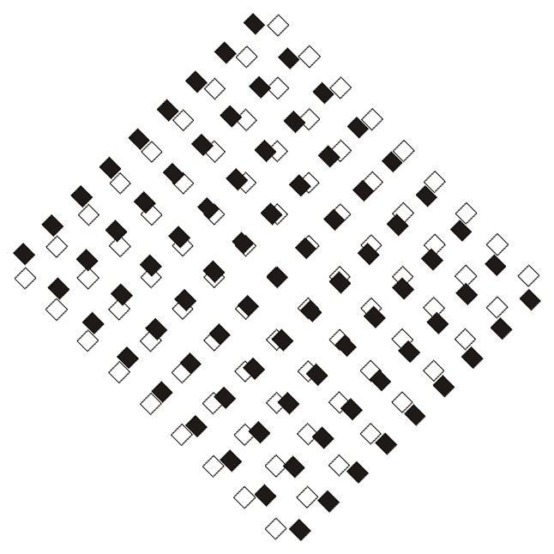
Cross polarization

Slide 8
Here is Rai Weiss’s calculation, as he learned to do it from Pirani
Rai knew that an interferometer compares the light travel time through one arm with the light travel time through the other arm.
For light moving along the x axis, we are interested in the interval between points with non-zero dx and dt, but with dy = dz = 0:

Slide 9
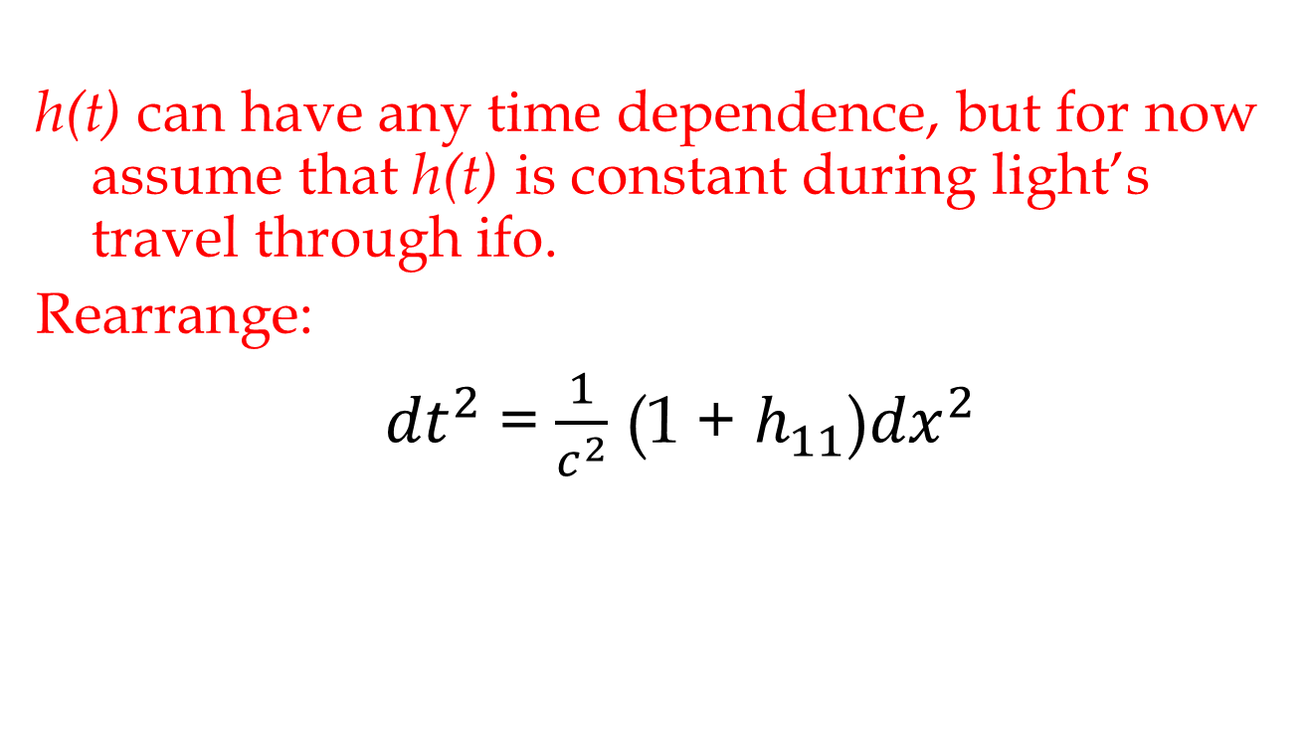
Solving for variation in light travel time: start with x arm
h(t) can have any time dependence, but for now assume that h(t) is constant during light’s travel through ifo.
Rearrange:
${dt}^{2}$ = $\frac{1}{c^{2}}$ (1 + $h_{11}$)${dx}^{2}$

Slide 10
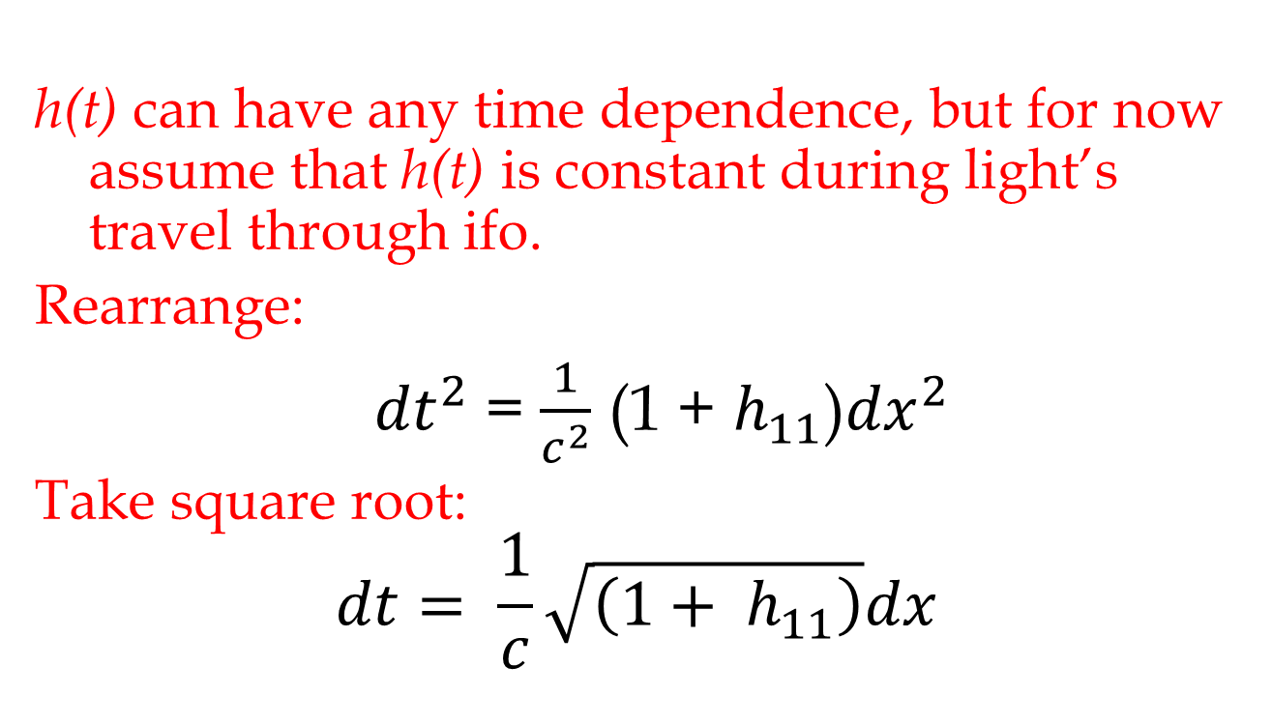
Solving for variation in light travel time: start with x arm
h(t) can have any time dependence, but for now assume that h(t) is constant during light’s travel through ifo.
Rearrange:
${dt}^{2}$ = $\frac{1}{c^{2}}$ (1 + $h_{11}$)${dx}^{2}$
Take square root:
$$dt= \frac{1}{c}\sqrt{\left(1+ h_{11}\right)}dx$$

Slide 11
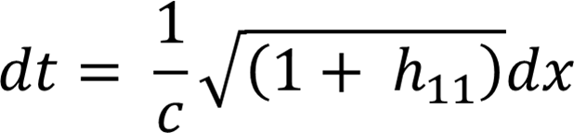

Variation in light travel time through x arm
Now, approximate the square root:
$$dt= \frac{1}{c}\left(1+ h_{11}/2\right)dx$$

Slide 12
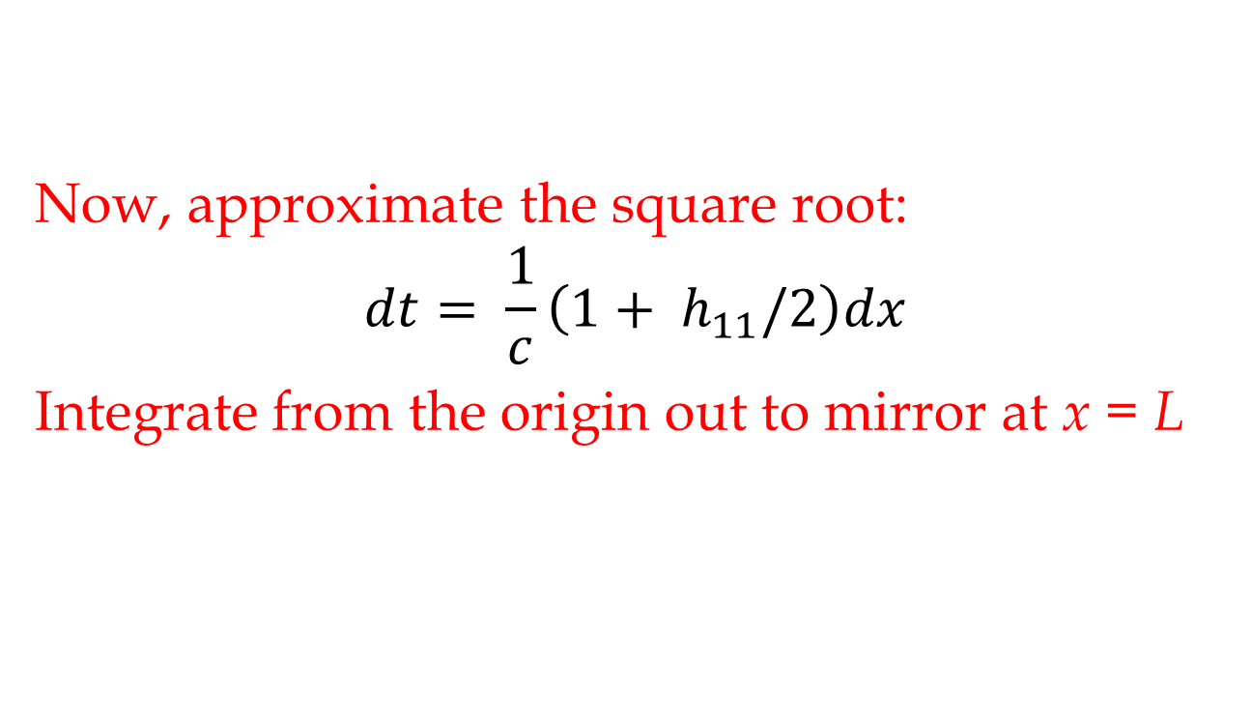
Variation in light travel time through x arm
Now, approximate the square root:
$$dt= \frac{1}{c}\left(1+ h_{11}/2\right)dx$$
Integrate from the origin out to mirror at x = L

Slide 13

Variation in light travel time through x arm
The time it takes for light to get to x = L is
$$t_{ow}=\frac{L}{c}+Δt_{ow}$$
where
$Δt_{ow}$ = $h_{11}L/2c$.

Slide 14
Comparison with travel time in the y arm
(In doing this calculation, we choose coordinates that are marked by free masses.
  “Transverse-traceless (TT) gauge”
  Thus, end mirror is always at x = L. )
Round trip back to beam-splitter:
y-arm (h₂₂ = - h₁₁ = -h):
Difference between x and y round-trip times:

Slide 15
Interferometer output vs. travel-time difference (expressed as phase difference between x and y light beams)
Power
phase difference Δφ (cycles)

Slide 16
Interpretation of this
Pirani-inspired calculation
A gravitational wave’s effect on one-way travel time:
Just as if the arm length is changed by a fraction
In the TT gauge, we say that the masses didn’t move (they mark coordinates), but that the separation between them changed.
  Metric of the space between them changed.

Slide 17
We can switch back and forth, at will, with a force interpretation
We can also interpret the same physics in a different picture, using different coordinates. Here, define coordinates with rigid rods, not free masses.
With respect to a rigid rod, masses do move apart. In this picture, it is as if the gravitational wave exerts equal and opposite forces on the two masses.
This is the best way to understand Weber’s bars.

Slide 18
Can Weiss’s calculation be right?
Have you ever wondered:
“Doesn’t a gravitational wave affect both the light and the test masses? If so, isn’t a gravitational wave unobservable?”

Slide 19
People often wonder about this “rubber ruler puzzle”
If a gravitational wave stretches space, doesn’t it also stretch the light traveling in that space?
If so, the “ruler” is being stretched by the same amount as the system being measured.
And if so, how can a gravitational wave be observed using light?
How can interferometers possibly work?

Slide 20
A related case: the expanding universe
In cosmology, one typically uses co-moving coordinates, marked by freely-falling test masses (i.e., galaxies).
As the universe expands
  galaxies get farther apart
  light traveling through the universe is stretched (cosmological redshift)
Do galaxies move? Depends who you ask …

Slide 21
Light in an interferometer arm
Imagine many freely-falling masses along arms of interferometer.
Test case: imagine that a step function gravitational wave, with amplitude h and + polarization, encounters interferometer.
Along x arm, test masses suddenly farther apart by (1+h/2).
Wavefronts near each test mass stay near the mass. (No preferred frames in GR!)

Slide 22
If the arms are stretched, then the light is stretched.
The arms of an interferometer are lengthened by a gravitational wave.
The wavelength of the light in an interferometer is also lengthened by a gravitational wave, by the same factor.

Slide 23
OK, so how can interferometers work?
The argument given above proves that there is no instantaneous response to a gravitational wave.
But, we don’t just care about the instantaneous response. We watch the entire history of the interferometer output.

Slide 24
The time-dependent response
The x arm was lengthened by the gravitational
wave.
Light travels at c. So, light will start to arrive
late, as it has to traverse longer distance than
it did before the wave arrived.
Delay builds up until all light present at wave’s
arrival is flushed out. Then delay stays
constant at Δτ = h(2NL/c).

Slide 25
Consider the DC response …
New light produced by the laser (after gravitational wave has passed by) isn’t affected by the gravitational wave.
(Its wavelength is determined by the length of a rigid resonant cavity.)
So if we wait to measure using all “new light”, it must reveal the changed arm lengths.

Slide 26
We never (or never should have) said that we were using light as a ruler.
Pirani taught us to use the travel time of light signals between free masses to sense the passage of a gravitational wave.
That is what Rai Weiss did from the beginning.
In the end, there is no puzzle: Interferometers can work.

Slide 27
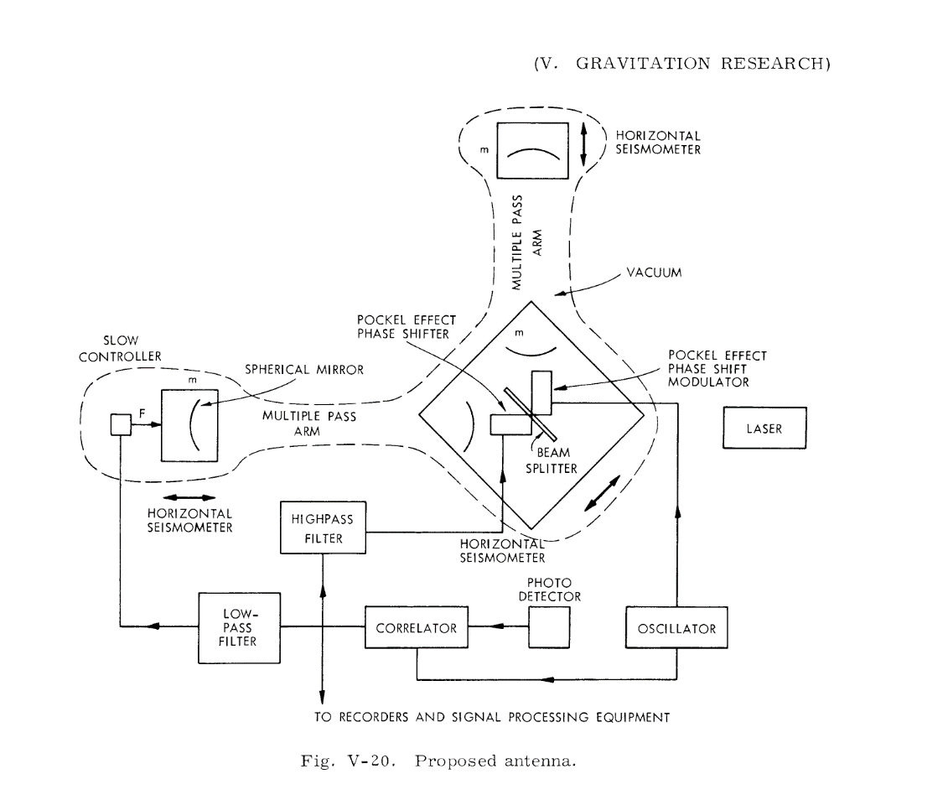
Rai Weiss envisions LIGO in 1972
Weiss thought about Weber’s claimed detections. True or not, he saw how to do many orders of magnitude better, by implementing Pirani’s free-test-masses-measured-by-lasers as a Michelson interferometer. Arms could be kilometers long. Lasers could measure sub-nuclear distances.
ΔL/L ~ 10⁻²¹ could be achieved.

Slide 28
Key features of a practical implementation
Tidal character of wave argues for test masses as far apart as practicable. Perhaps masses hung as pendulums, kilometers apart.

Slide 29
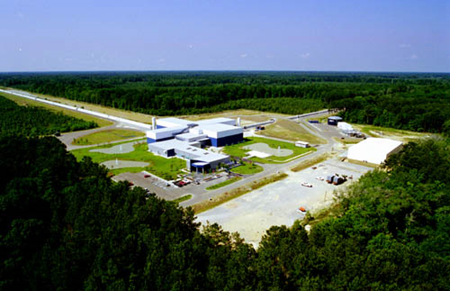
LIGO Observatory at Livingston, LA

Slide 30
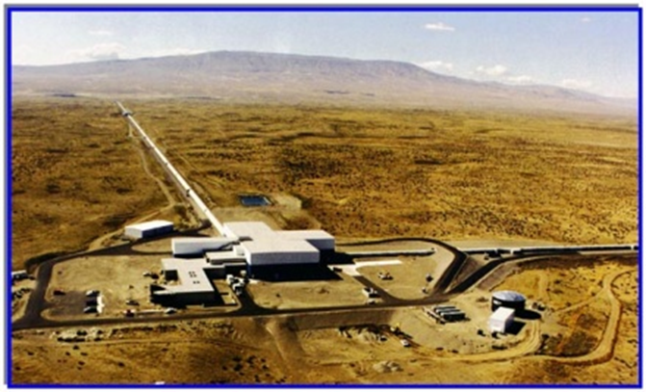
LIGO Observatory at Hanford, WA

Slide 31
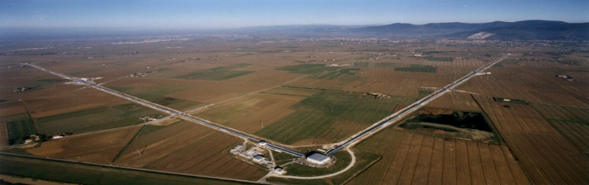
Virgo
Cascina, Italy

Slide 32
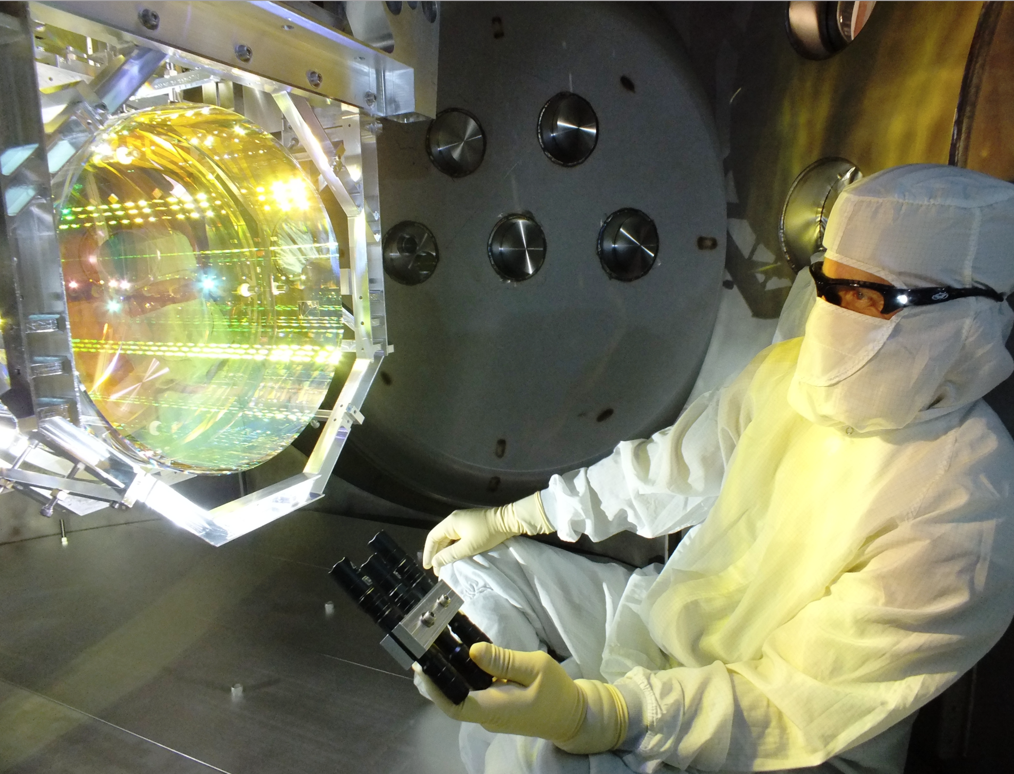
Implementing one of Pirani’s “particles”
Test Mass

Slide 33
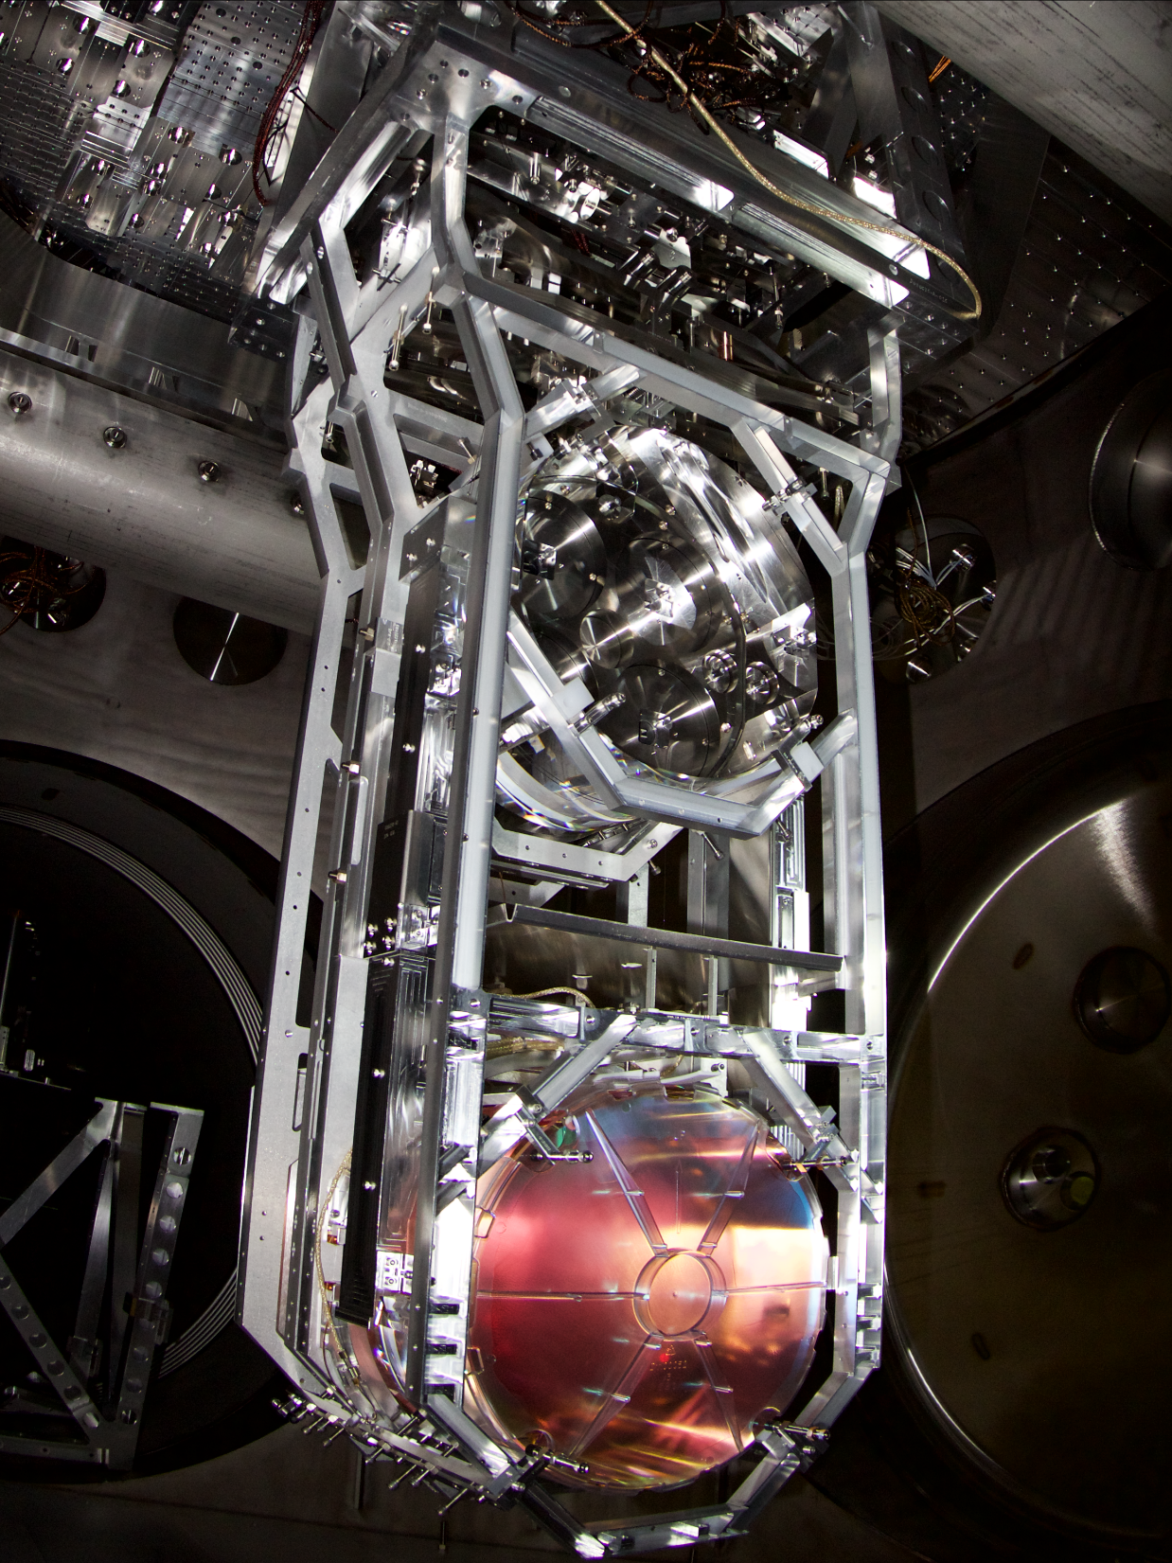

Making a “particle” that is quiet and free
Test Mass Suspension
40 cm

Slide 34
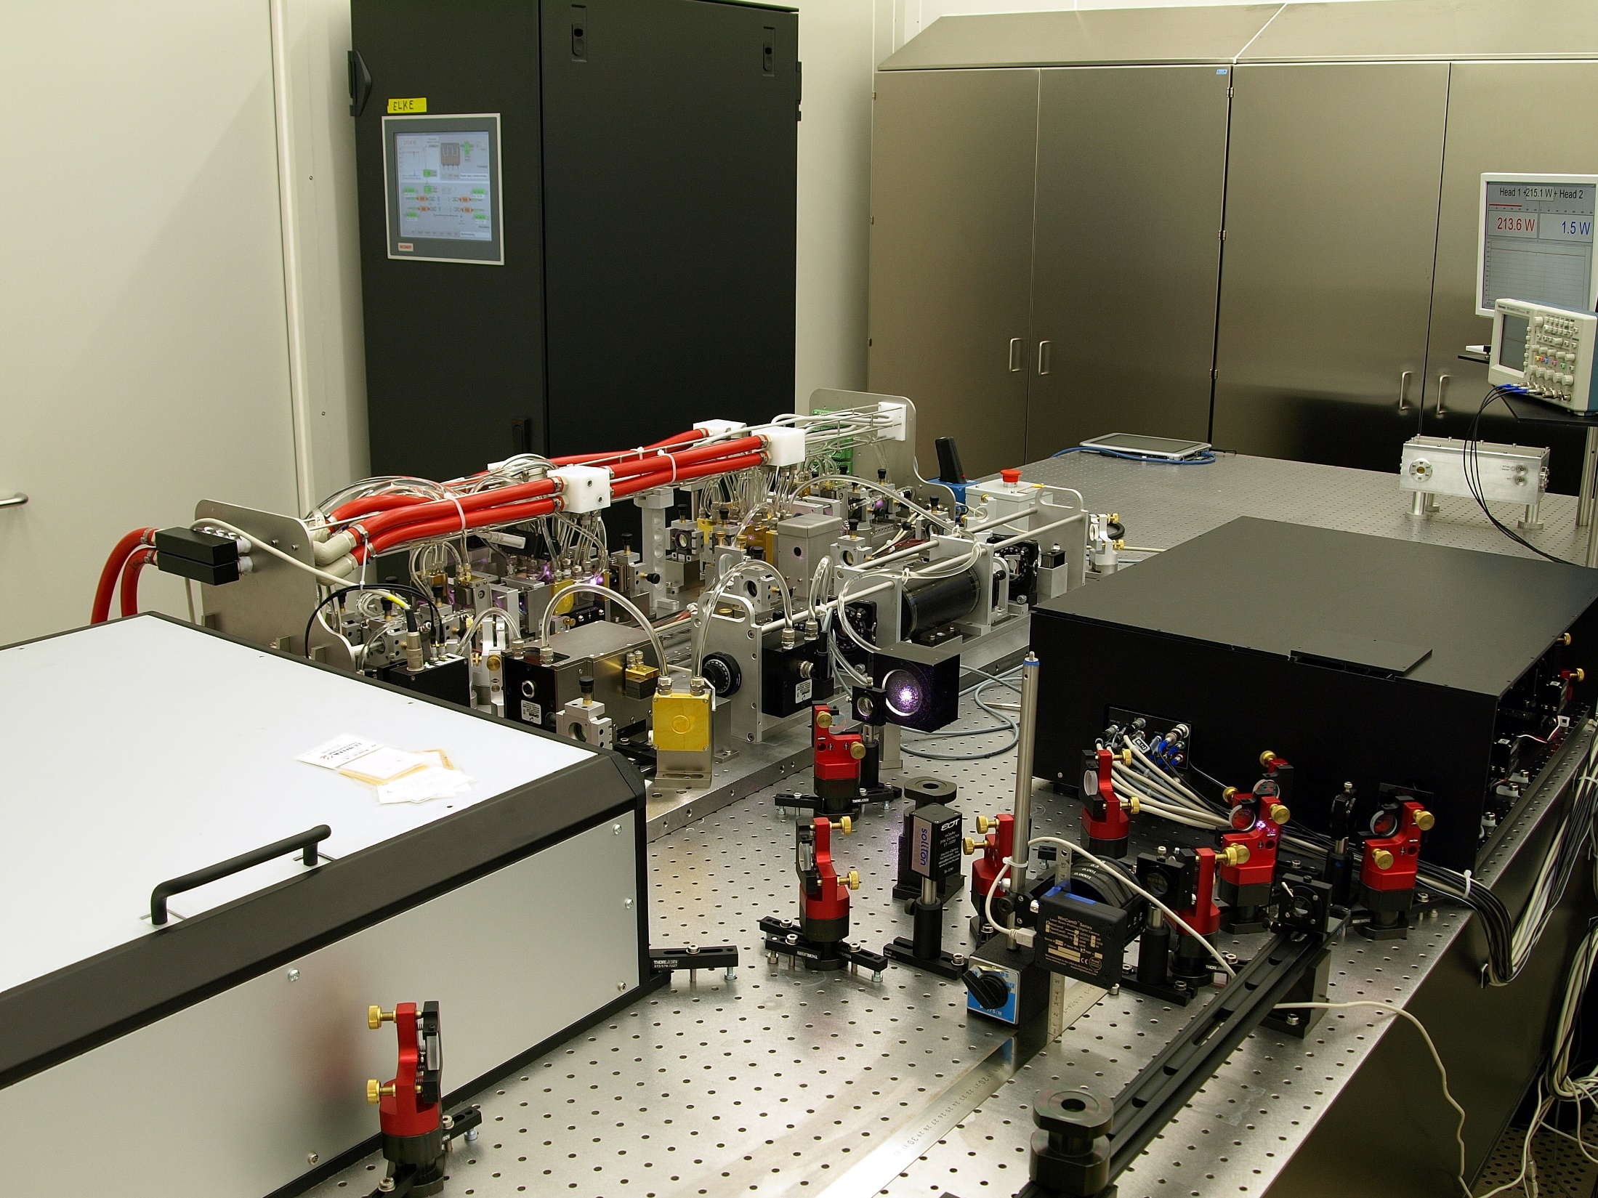
Laser supplies photons for the “measurement of relative acceleration of several different pairs of particles”
200W Pre-Stabilized Laser

Slide 35
Gravity wave detectors
Need:
  A set of test masses,
  Instrumentation sufficient to see tiny motions,
  Isolation from other causes of motions.
Challenge:
  Best astrophysical estimates had long predicted fractional separation changes of at most
  1 part in 10²¹, or less.
  (We now know that those estimates were correct.)

Slide 36
Gravitational wave detection is almost impossible
What is required for gravitational wave detection to succeed:
sensitivity to signals with h ~ 10⁻²¹ (or better!),
  which is equivalent to ultra-subnuclear position sensitivity,
in the presence of much larger noise,
using free masses (to respond to gravitational wave freely) but nevertheless having interferometer stay aligned and close enough to an operating point to give a linear response

Slide 37
Sensitivity to signals with h ~ 10⁻²¹
Why it is “impossible”:
Sensitivity h_{rms} can be expressed as
Natural “tick mark” on interferometric ruler is one wavelength.
Michelson could read a fringe to λ/20, yielding h_{rms} of a few times 10⁻⁹.
aLIGO noise was about h_{rms} ~ 10⁻²².

Slide 38
Ultra-subnuclear position sensitivity
Why people thought it was impossible:
Mirrors made of atoms, 10⁻¹⁰ m.
Mirror surfaces rough on atomic scale.
Atoms jitter by large amounts.

Slide 39
Large mechanical noise
How large?
Seismic: x_{rms} ~ 1 μm.
  Can you filter it enough?
Thermal:
  mirror’s CM: ~ 3 x 10⁻¹² m.
  mirror’s surface: ~ 3 x 10⁻¹⁶ m.
  No filtering is possible. Can lower the temperature, but by enough?

Slide 40
Interferometry with free masses
What’s “impossible”: everything!
Mirrors need to be very accurately aligned (so that beams overlap and interfere) and held very close to an operating point (so that output is a linear function of input.)
Otherwise, interferometer is dead or swinging through fringes.
Michelson bolted everything down.

Slide 41
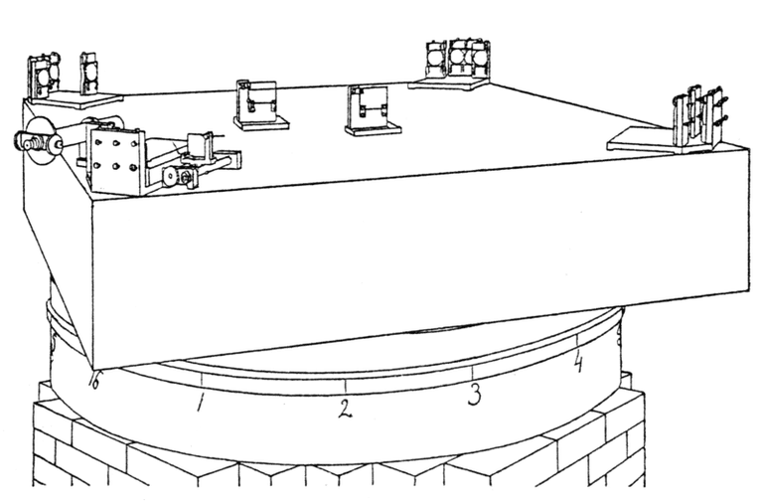
Michelson and Morely 1887
(note the rigid mounts for all mirrors)

Slide 42
Gravitational wave detection does work!
All of these challenges sound impossible.
And yet, all of them can be met.
Detectors have now seen signals whose peak strain is 10⁻²¹ with signal-to-noise ratios of more than 20.
But how is it possible?

