Slide 1
Gravitational Waves Fundamentals and Early History 5
Peter Saulson Martin A. Pomerantz ‘37 Professor of Physics
Syracuse University

Slide 2
Gravitational wave detection is almost impossible
What is required for gravitational wave detection to succeed:
sensitivity to signals with h ~ 10⁻²¹ (or better!),
which is equivalent to ultra-subnuclear position sensitivity,
in the presence of much larger noise,
using free masses (to respond to gravitational wave freely) but nevertheless having interferometer stay aligned and close enough to an operating point to give a linear response

Slide 3
Outline
Control systems
Applications to pointing, active damping, active vibration isolation
Locking (F-P cavity, ifo)
We’ve made a “rigid” and linear system without “material rigidity”
Challenges of control systems

Slide 4
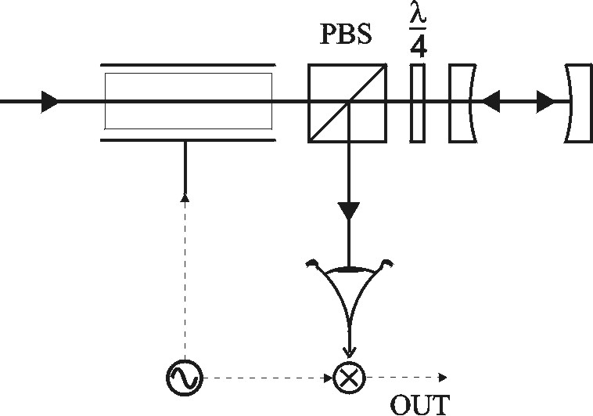
How can we match λ to the length of a resonant cavity?

Slide 5
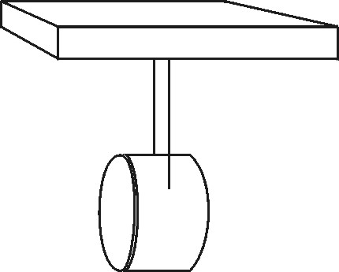
How can we modify the response of a test mass suspension?

Slide 6
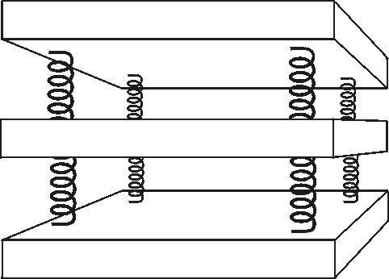
How can we improve vibration isolation?

Slide 7
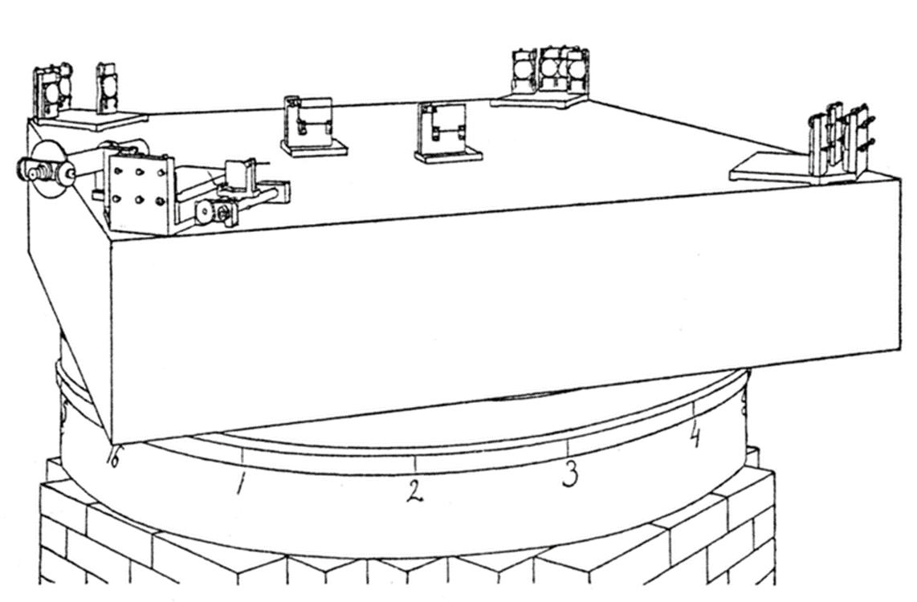
GW ifo needs mirrors to be free! Must lock multiple F-P cavities.

Slide 8
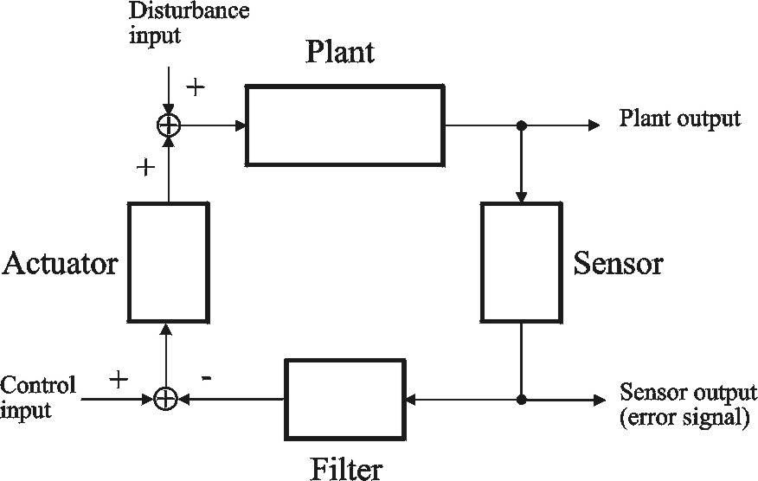
A feedback control system (a.k.a. “servo”)

Slide 9
Parts of a servo
Plant: The pre-existing system that you want to control or modify.
Sensor: Generates an (electronic) signal proportional to the plant’s output.
Actuator: Acts on the plant to change its output in the desired way.
Compensation filter: (more on this later)

Slide 10
Feedback can hold the plant near a chosen operating point
Control input is zero. But disturbance inputs cause the plant output to vary.
Sensor measures the fluctuating plant output.
Actuator applies a force proportional to the negative of the plant output, thus holding the plant near the chosen operating point.
Feedback reduces sensitivity to disturbance inputs.

Slide 11
Feedback can modify the dynamics of the plant
Plant responds to control inputs or to disturbance inputs.
Sensor measures the response, which is modified by the compensation filter.
Actuator applies a force that combines with inputs, so that the response of the plant is different than the response to external inputs alone.

Slide 12
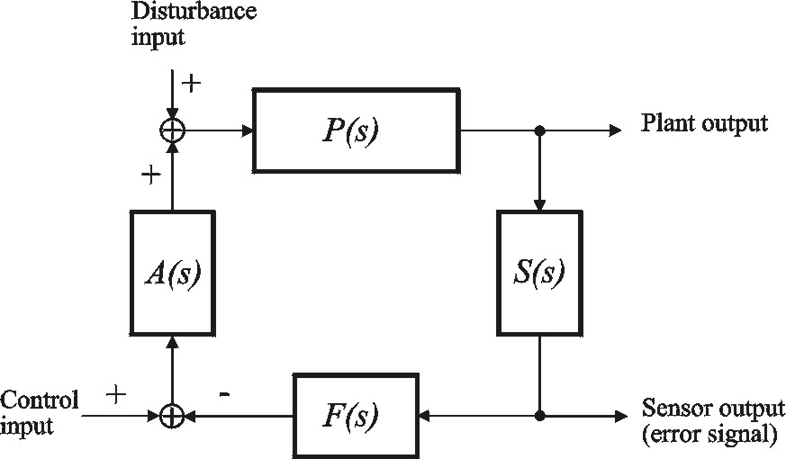
Dynamics of a servo

Slide 13
Loop Transfer Function (a.k.a. loop gain)
The loop transfer function of a feedback control system is given by
G(f) determines the behavior of the servo, how it modifies the performance of the plant, and also the stability of the system.

Slide 14
Benefits of feedback: Closed loop transfer function
Let H(f) be a transfer function between any two points when the loop is not closed.
Let H_{cl}(f) be the same transfer function when the loop is closed.
Then

Slide 15
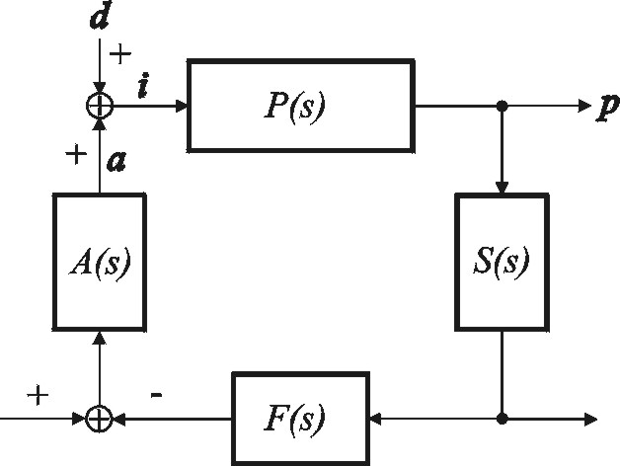
Signals in servo

Slide 16
Derivation of closed loop transfer function

Slide 17
Benefits of feedback
Servo does a lot at frequencies where 1+G is large, a little where 1+G is of order unity, and almost nothing where G<<1.
This is one reason why we say that the benefits of feedback are all encoded in the loop transfer function G.

Slide 18
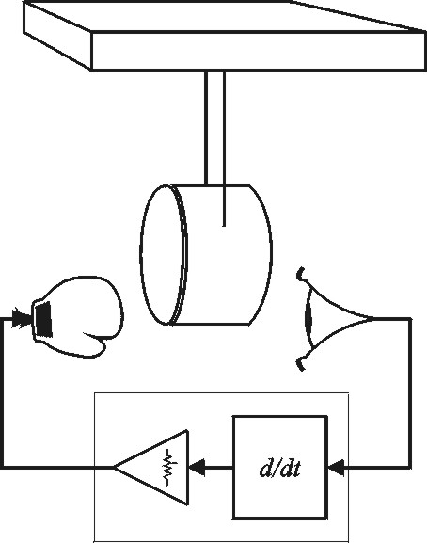
Example: active damping of pendulum

Slide 19
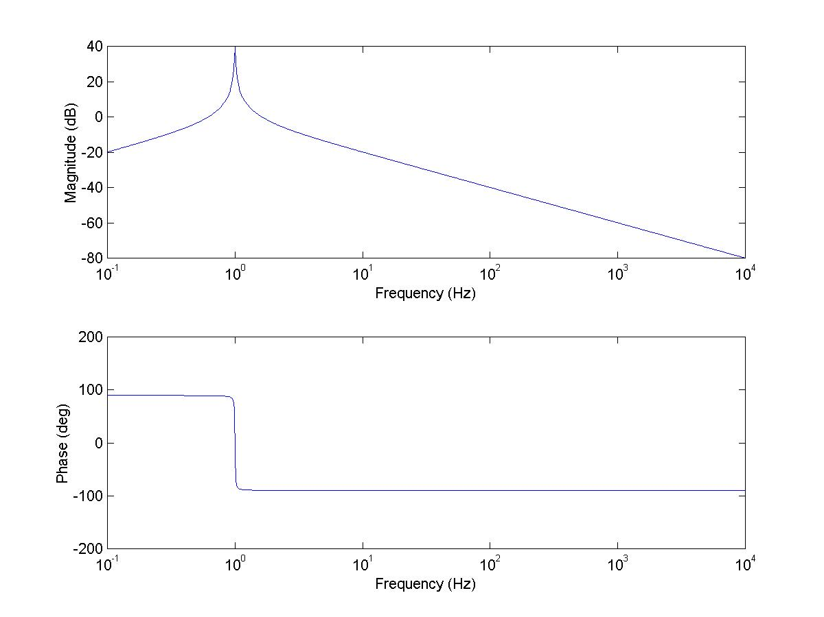
Active damping: loop transfer function

Slide 20
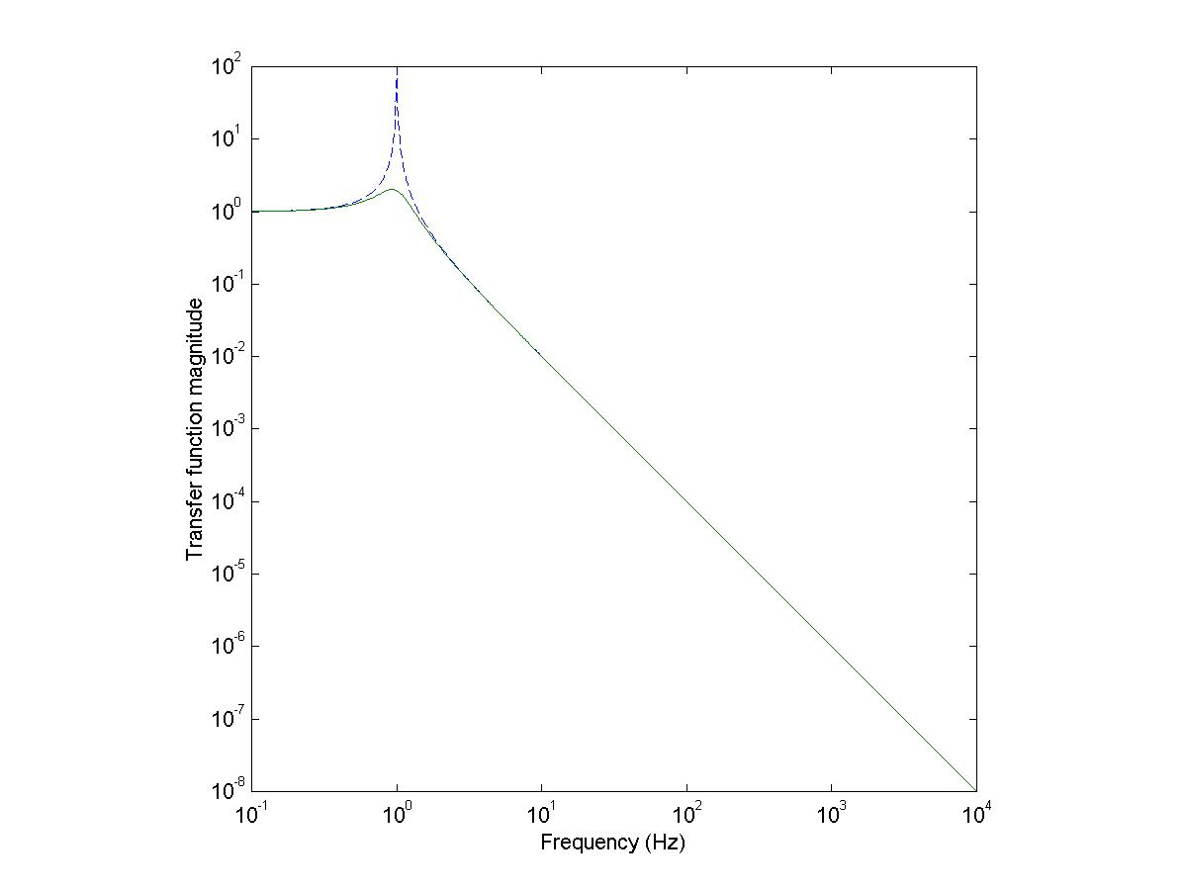
Active damping: Open loop, closed loop transfer functions

Slide 21
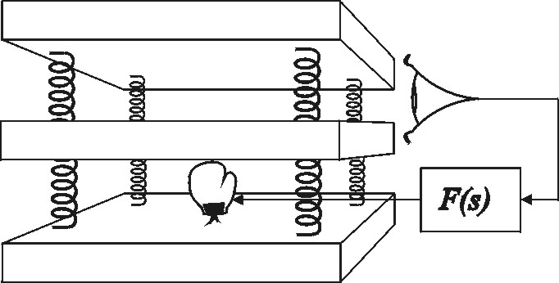
Example: Active vibration isolation

Slide 22
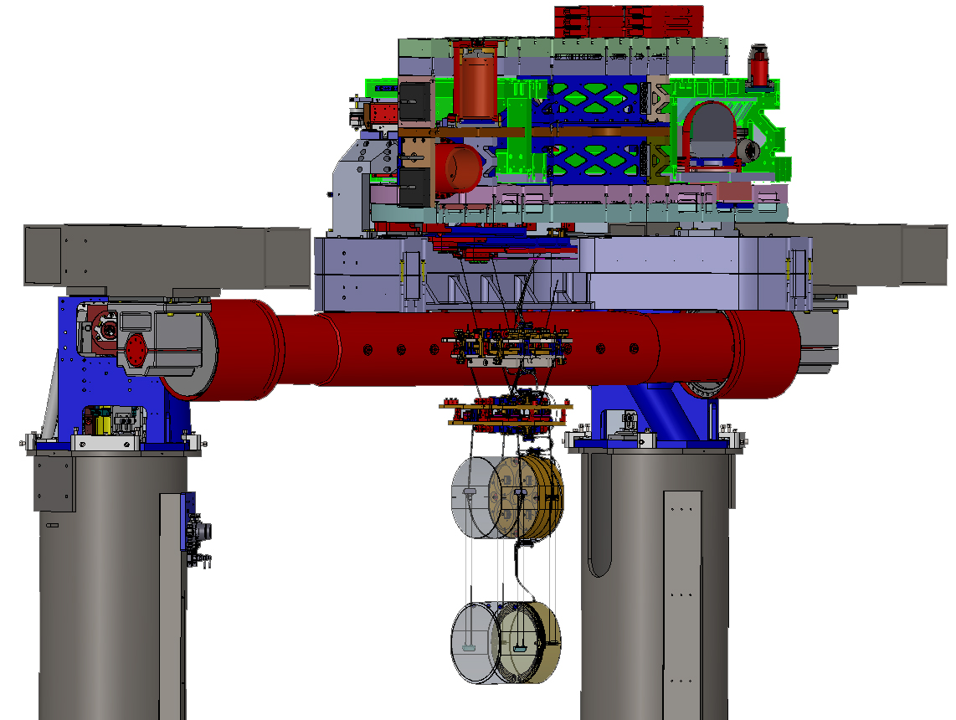
aLIGO also has active isolation
+Z
Stage 2 Actuation Plane
+X
+V
+Y
182 cm
Optical Table
Suspension Point
+L
+T
(X , Y ) [mm]
(+200, +426.1) ITM
(+200 , -369.8) ETM

Slide 24
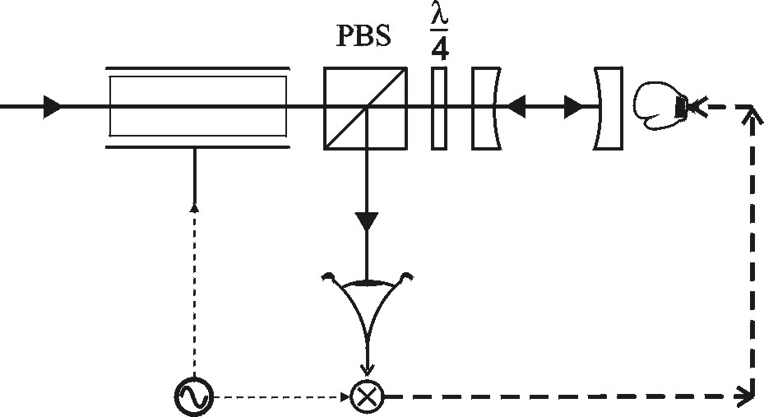
Example: Pound-Drever-Hall locking of a resonant cavity

Slide 25
On resonance we get a very steep dependence of reflected light phase on cavity length

Slide 26
GW ifo needs mirrors to be free! Must lock multiple F-P cavities.

Slide 27
How Does it All Hang Together?
Michelson
Interferometer
+ Fabry-Perot
Arm Cavities
+ Power Recycling
end
test mass
recycling
mirror
input
test mass
Laser
300 W
20 kW
6 W
GW signal  strain
h = ΔL/L

Slide 28
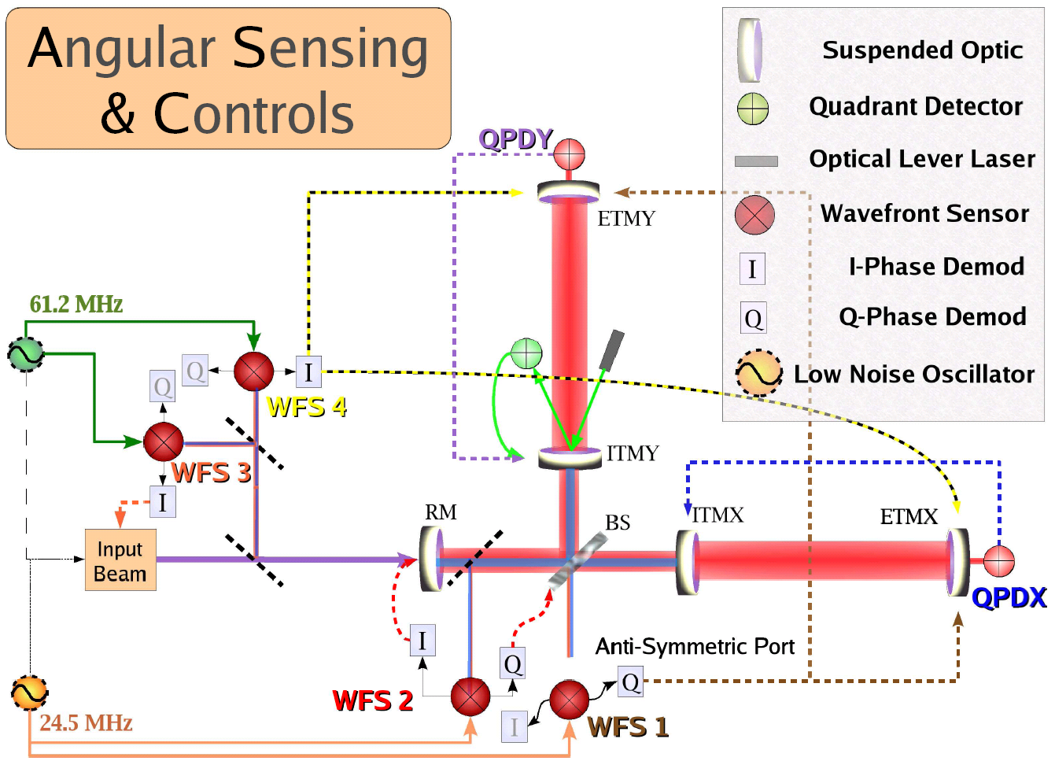
How Does it All Hang Together?

Slide 29
First Lock for a LIGO Interferometer
Requires test masses to be held in position to 10⁻¹⁰ meter (atomic diameter)
“Locking the interferometer”
end test mass
Light bounces back and forth along arms about 100 times
Light is “recycled” about 50 times
input test mass
Laser
signal

Slide 30
Steps to Locking the Interferometer
Composite Video
Y Arm
Laser
X Arm
signal

Slide 31
“Celebrating” the first LIGO ifo lock, 20 Oct 2000 at the Hanford control room
In the photo at left, the top two images on the screen show the light built up in the long cavities, while the image on the lower left shows the built up recycled laser light at the beam splitter. These images are dark in the absence of resonance, when only the laser light shining on the recycling mirror (shown at lower right on screen) can be seen.
L to R: Robert Schofield, Rai Weiss, and Bill Kells

Slide 32
“Scientists in triumphant repose around control room consoles.” (20 Oct 2000)
In foreground from left are David Ottoway and Michael Landry of LIGO Hanford Observatory; Luca Matone, Stan Whitcomb, Matt Evans and Nergis Mavalvala of Caltech; William Butler of the University of Rochester. Scientist Thomas Nash from Fermilab is in the background.

Slide 33
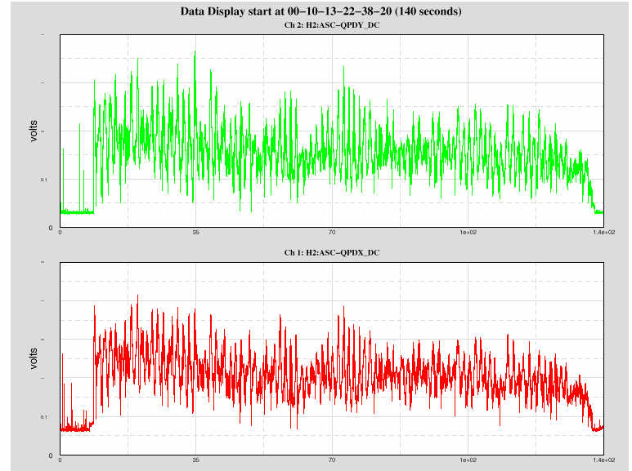
Full Interferometer Locking
Still a bit tenuous…….
Locked
Unlocked
2 Minutes

Slide 34
“Costs” of feedback
Some cost: Feedback control systems need extra parts, and those need to be carefully designed.
Biggest “cost”: To ensure that the servo will be stable when the loop is closed.
Frequency dependence of the loop transfer function G is critical. This is the main role of the compensation filter F.
This is a very rich subject!

Slide 35
Stability and causality
Recall:
What happens if, for some f, G(f) = -1?
Closed loop response diverges!
Why not just avoid this, e.g. by making G large for all f?
Causality requires that response of physical systems can’t keep fixed magnitude and phase to arbitrarily high f.
Speed of light
In mechanical systems, the speed of sound is the real limit!

Slide 36
Ensuring stability
Generically, at high frequencies we accumulate large phase lags.
When φ = -180 deg, we’ve picked up an unwanted change of sign.
The standard way to deal with this is by ensuring that the magnitude of the loop transfer function G is small for all f above that point.
Ensuring stability requires careful design of the compensation filter F.

Slide 37
Limits to filter design

Slide 38
Stability tests
Feedback designers most often study the Bode plot of G(f), and have developed rules of thumb for estimating when a loop will be stable.
For example, if the phase of G only departs from 0 by more than π at frequencies at which the magnitude of G is less than 1, the loop is usually stable.
N.B.: There is no rigorous stability test that can always be applied by study of the Bode plot.

Slide 39
Rigorous stability tests
The Nyquist diagram, in which one plots G(f) in the complex plane. If there are no encirclements of (-1,0), the loop is stable.
The root locus method. If all of the roots of the closed loop response lie in the left half-plane, the system is stable.

Slide 40
Design rule: Make MIMO system look like many SISO systems
There’s a lot going on to make an interferometer sit still in the right way.
In principle, many things are interacting – inherently a multi-input/multi-output (MIMO) system.
It is almost always best (and, fortunately, usually possible) to find pairs of single error signals and single actuation points, so that one is designing a (large) set of single-input/single-output (SISO) systems.

Slide 41
Locking an interferometer is a complicated sequence
Locking an interferometer made up of resonances is complicated.
It is bad enough that mirrors can swing by large amounts compared to the dynamic range of the “Pound-Drever-Hall” error signal.
In addition, gains (and even signs!) of some error signals depend on which cavities lock first and which aren’t locked yet.
The locking sequence needs to be controlled by 1000’s of lines of code.

Slide 42
When all else fails, there’s “modern control theory”
For complicated systems, it is often best to abandon frequency domain methods, and work directly with a model of the equations of motion of the system.
A well-developed version of this is called state space control. There are good books on this subject …

Slide 43
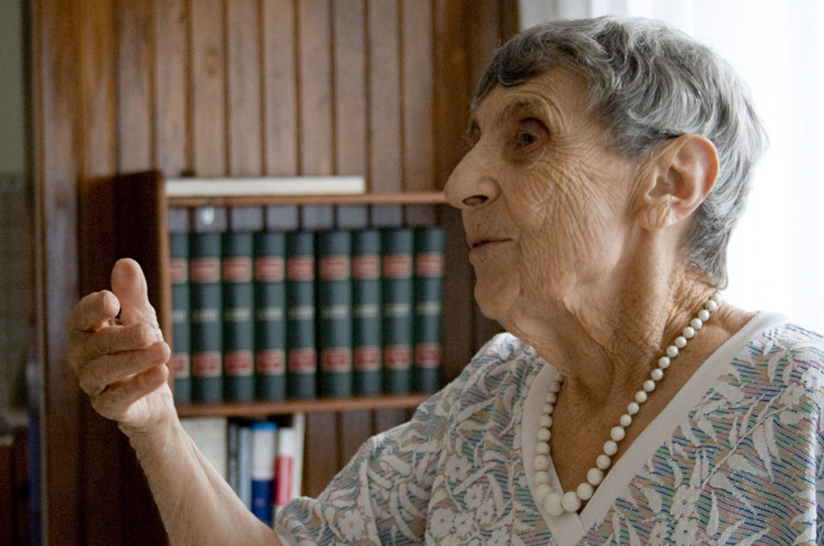
Cécile DeWitt-Morette (1922 – 2017), founder of the Ēcole de Physique des Houches
Around the time she hosted the Chapel Hill Conference
Late in her life

Slide 44
Cécile DeWitt-Morette hiking nearby with Bryce DeWitt

Slide 45
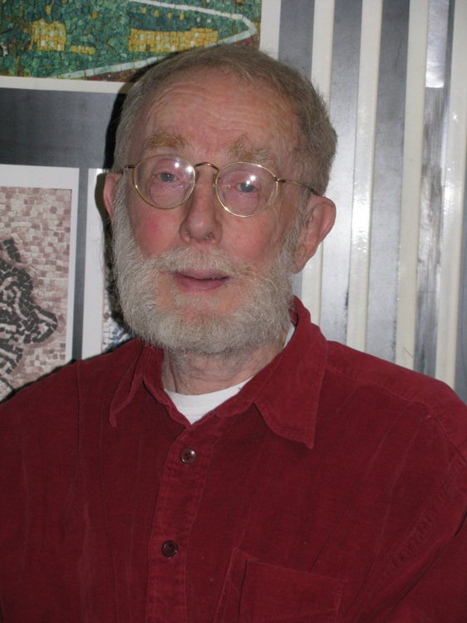
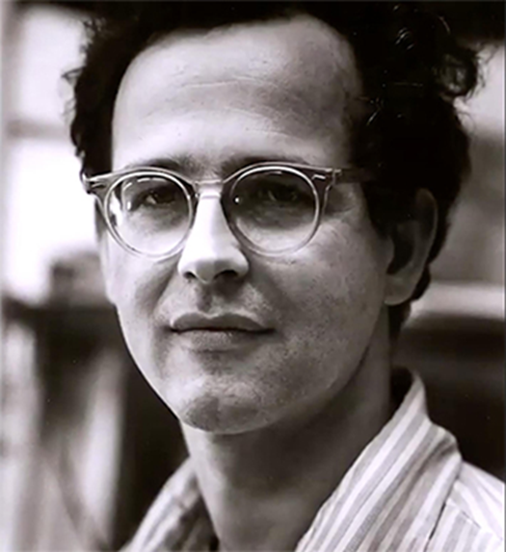
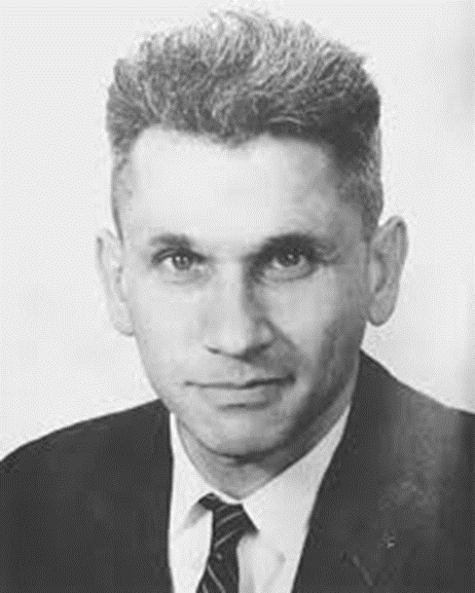
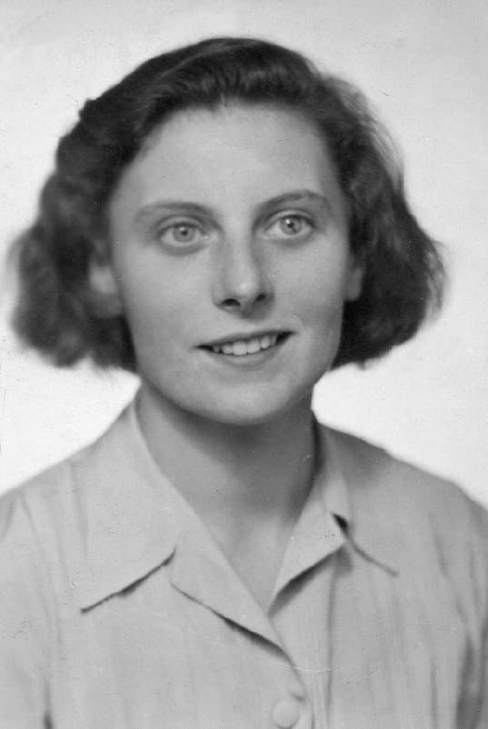
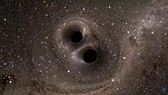
We are so blessed to be able to be here. We owe a great debt to the hard work of so many others, both the heroes whom we honor, and the many people who have “done without” so that we can participate in this wonderful endeavor.
Les Houches Summer School
Family, friends, taxpayers, et al.
F. Pirani
Rai Weiss
Joe Weber
Source of GW150914
Cécile DeWitt

Slide 46
Each of our future world lines will be unique. Find the one that you can love with all your heart, all your soul, and all your might!
Les Houches Summer School

